Slide 1
SVM vs GLM
AMS 597 FINAL PROJECT
Weichuan Deng
Notes:
we generalize this is more like if you if you're familiar with a mix model, you know, the coefficients beta in our house we treated as fix effects. So the beta is is indeed is is is is just fixed the beta ****can also be random****. So what you have in the beta can be both fixed on the random then this recorded mixed model. So gentlemen media mix model will be a generalization from the linear model

Slide 2
Content
Background
Introduction
SVM model
Model building and Model comparison
Summary

Slide 3
Background

Slide 4
Background:
SVM:
The original SVM algorithm was invented by Vladimir N. Vapnik and Alexey Ya. Chervonenkis in 1963. In 1992, Bernhard E. Boser, Isabelle M. Guyon and Vladimir N. Vapnik suggested a way to create nonlinear classifiers by applying the kernel trick to maximum-margin hyperplanes. The current standard[according to whom?] incarnation (soft margin) was proposed by Corinna Cortes and Vapnik in 1993 and published in 1995.
Source: https://en.wikipedia.org/wiki/Support-vector_machine

Slide 5

Vladimir Naumovich Vapnik
(Russian: Владимир Наумович Вапник;
born 6 December 1936) is one of the main
developers of the Vapnik–Chervonenkis theory
of statistical learning, and the co-inventor of
the support-vector machine method, and support-vector clustering algorithm.
Source: https://en.wikipedia.org/wiki/Support-vector_machine

Slide 6
Introduction

Slide 7
Motivation:
Classifying data is a common task in machine learning.
linear classifier:
Suppose some given data points each belong to one of two classes, and the goal is to decide which class a new data point will be in. In the case of support-vector machines, a data point is viewed as a p-dimension vector (a list of p number), and we want to know whether we can separate such points with a (p-1)dimension hyperplane.
Source: https://en.wikipedia.org/wiki/Support-vector_machine

Slide 8
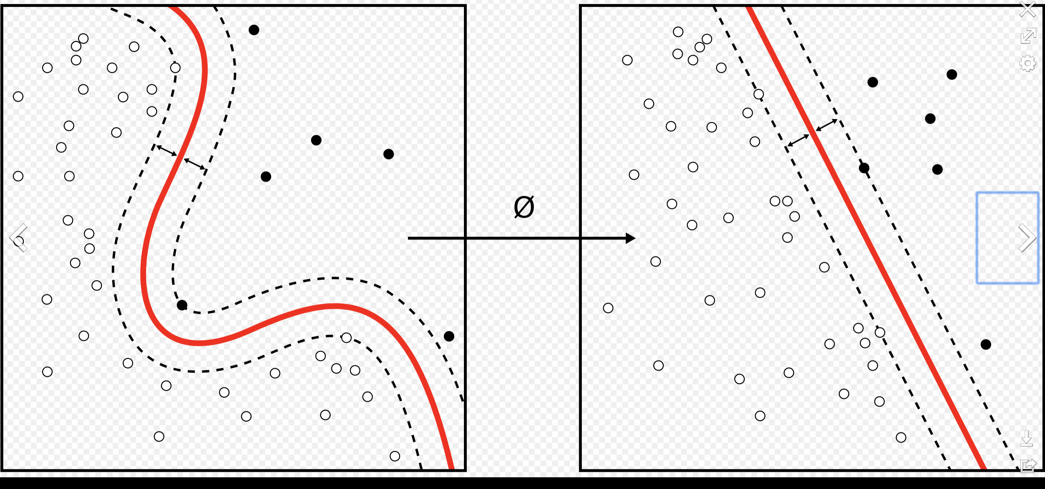
What is Support Vector Machine?
The objective of the support vector machine algorithm is to find a hyperplane in an N-dimensional space(N — the number of features) that distinctly classifies the data points.
Source: https://en.wikipedia.org/wiki/Support-vector_machine

Slide 9
SVM Model

Slide 10
Hard margin SVM
Definition: Find a perfect hyperplane which could separate every class perfectly.
if Yi(WT*Xi +b) ≥ 1:
then Xi is correctly classified
else:
Xi is incorrectly classified.
Source: https://towardsdatascience.com/support-vector-machines-svm-c9ef22815589

Slide 11
Hard margin SVM
If the points are linearly separable then only our hyperplane is able to distinguish between them and if any outlier is introduced then it is not able to separate them. So these type of SVM is called as hard margin SVM (since we have very strict constraints to correctly classify each and every datapoint).
Therefore, hard margin SVM could lead overfitting of the model.
Source: https://towardsdatascience.com/support-vector-machines-svm-c9ef22815589

Slide 12
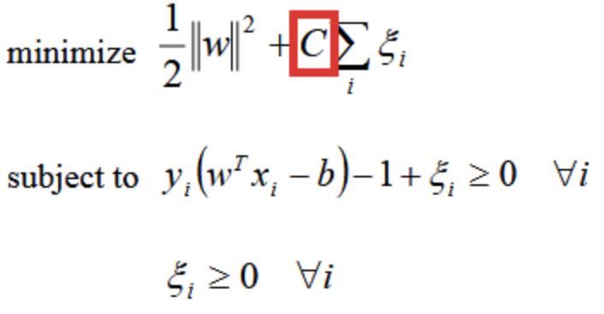
Soft margin SVM
Source: https://towardsdatascience.com/support-vector-machines-svm-c9ef22815589

Slide 13
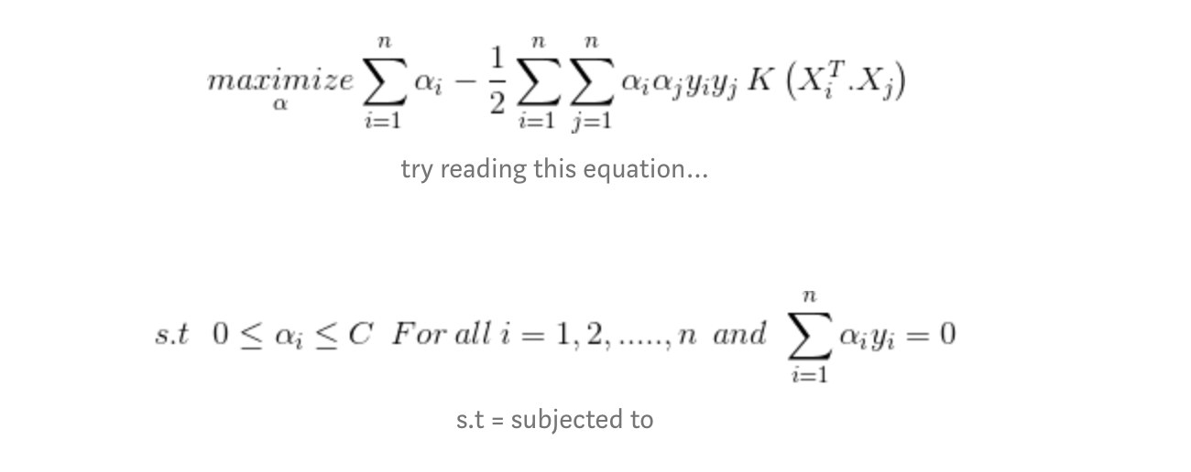
Kernel trick
The kernel is a way of computing the dot product of two vectors x and y in some (very high dimensional) feature space, which is why kernel functions are sometimes called “generalized dot product.
Source: https://towardsdatascience.com/support-vector-machines-svm-c9ef22815589

Slide 14
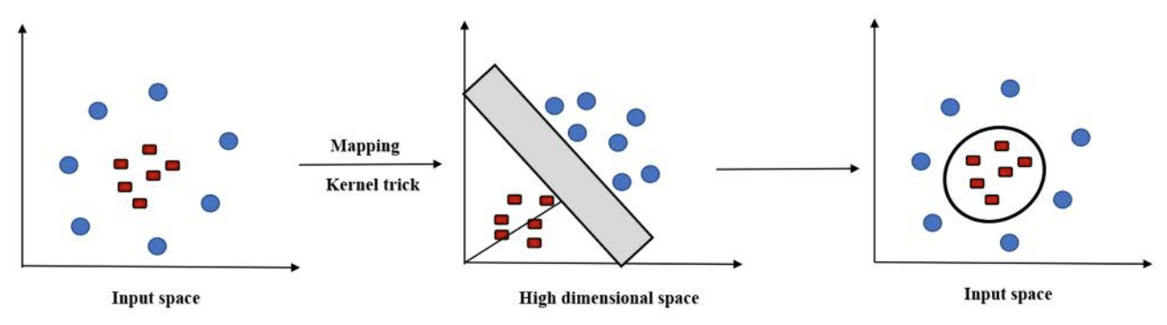
Kernel Function
The kernel function is what is applied on each data instance to map the original non-linear observations into a higher-dimensional space in which they become separable.
Source: Huang, S., Cai, N., Pacheco, P.P., Narrandes, S., Wang, Y. and Xu, W., 2018. Applications of support vector machine (SVM) learning in cancer genomics. Cancer Genomics-Proteomics, 15(1), pp.41-51.

Slide 15
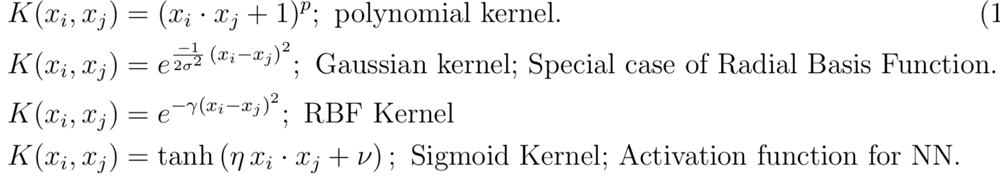
Kernel Function
Source: https://towardsdatascience.com/understanding-support-vector-machine-part-2-kernel-trick-mercers-theorem-e1e6848c6c4d

Slide 16
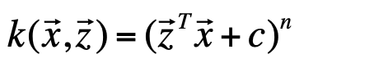
Polynomial kernel
Formula:
Where n is the “order” of the kernel, and c is a constant that allows to trade off the influence of the higher order and lower order terms.
Source: Crowley, J.L., 2012. Intelligent Systems: Reasoning and Recognition. Institut Polytechnique de Grenoble, Montbonnot, France. Lesson notes.

Slide 17
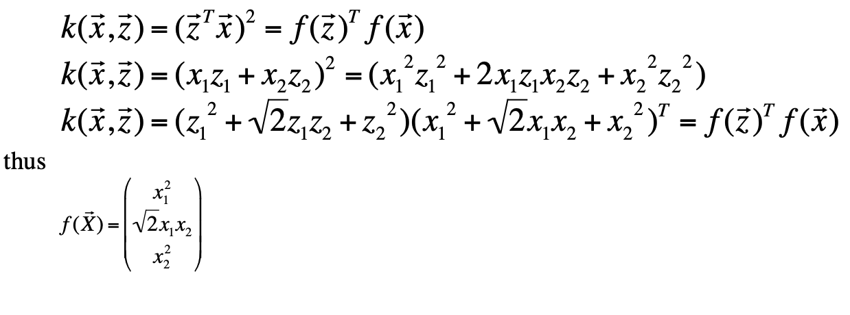
Polynomial kernel
Without the C term
Source: Crowley, J.L., 2012. Intelligent Systems: Reasoning and Recognition. Institut Polytechnique de Grenoble, Montbonnot, France. Lesson notes.

Slide 18
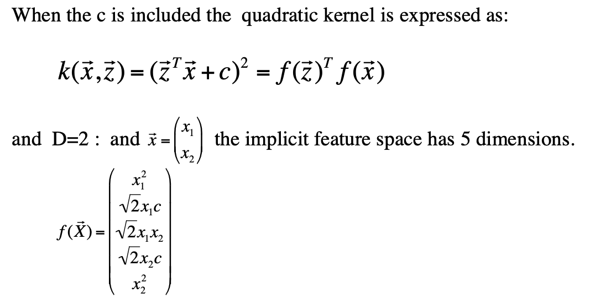
Polynomial kernel
Source: Crowley, J.L., 2012. Intelligent Systems: Reasoning and Recognition. Institut Polytechnique de Grenoble, Montbonnot, France. Lesson notes.

Slide 19
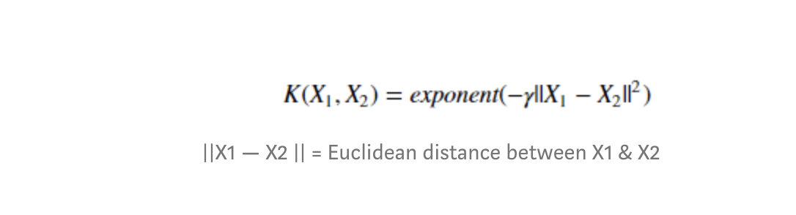
Radial Basis Function (RBF)
Gaussian RBF(Radial Basis Function) is another popular Kernel method used in SVM models for more. RBF kernel is a function whose value depends on the distance from the origin or from some point.
Source: https://towardsdatascience.com/support-vector-machines-svm-c9ef22815589

Slide 20
Radial Basis Function (RBF)
Parameter:
C: Inverse of the strength of regularization. Behavior: As the value of ‘c’ increases the model gets overfits. As the value of ‘c’ decreases the model underfits.
γ : Gamma (used only for RBF kernel) Behavior: As the value of ‘ γ’ increases the model gets overfits.As the value of ‘ γ’ decreases the model underfits.
Source: https://towardsdatascience.com/support-vector-machines-svm-c9ef22815589

Slide 21
Model Building

Slide 22
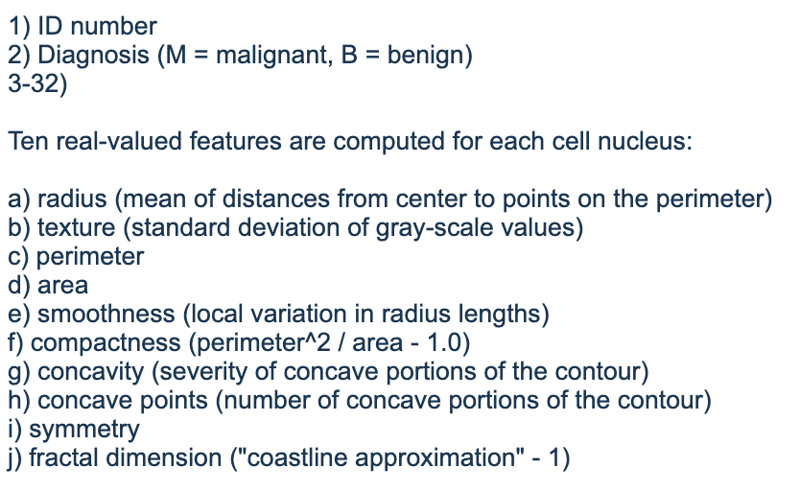
Variables
Source: https://archive.ics.uci.edu/ml/datasets/Breast+Cancer+Wisconsin+%28Diagnostic%29

Slide 23
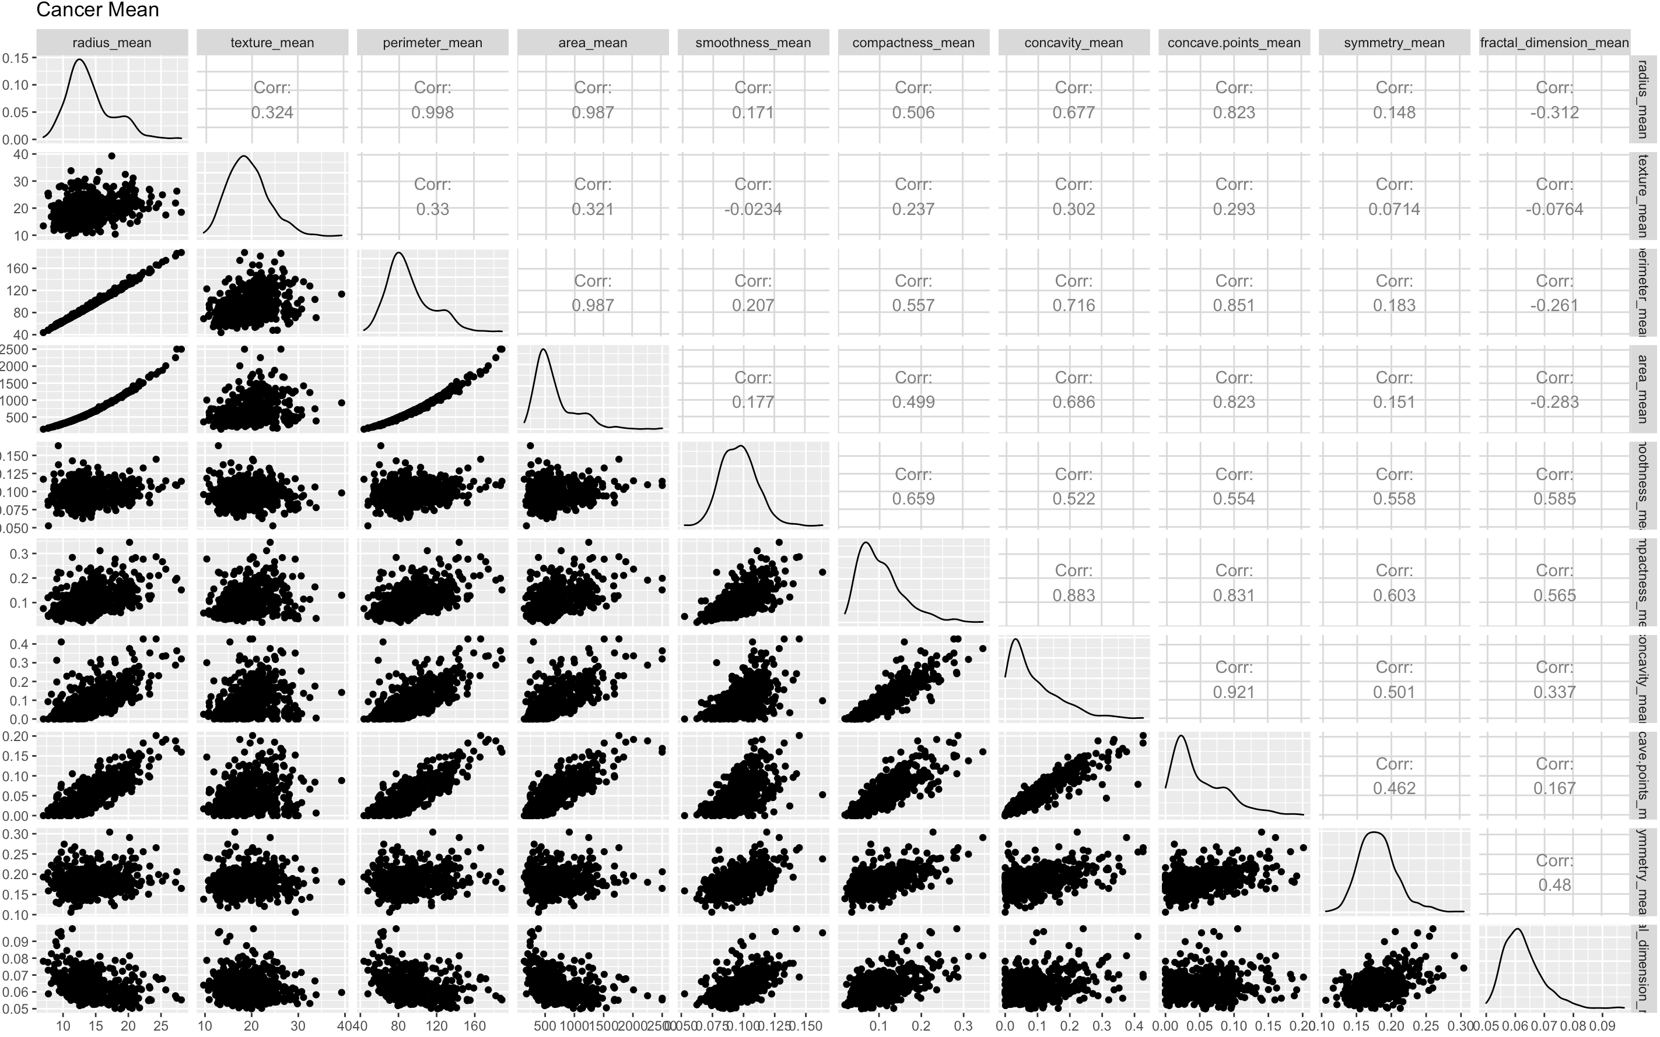
Correlation test
Highly correlation between some variables.

Slide 24
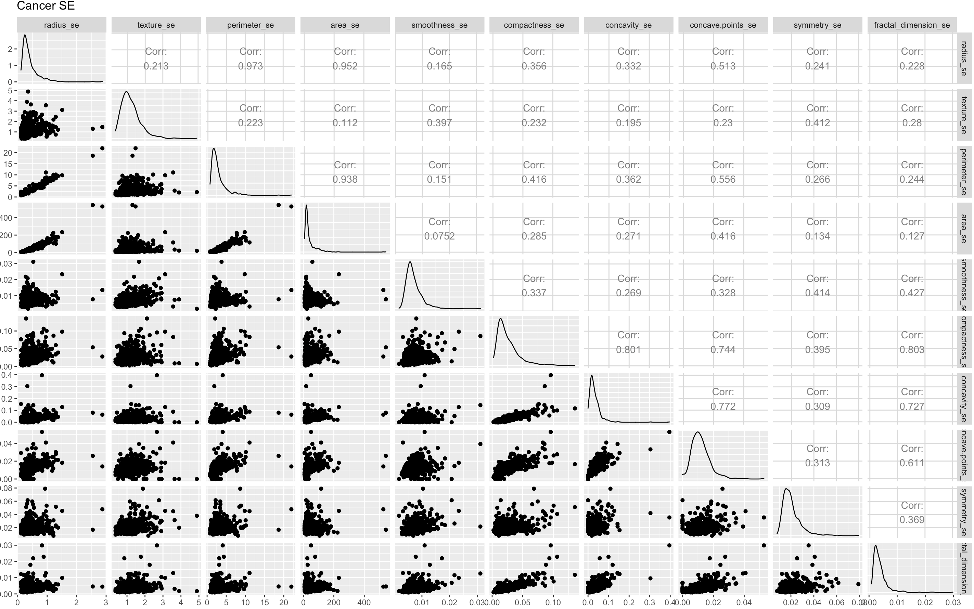
Correlation test
Highly correlation between some variables.

Slide 25
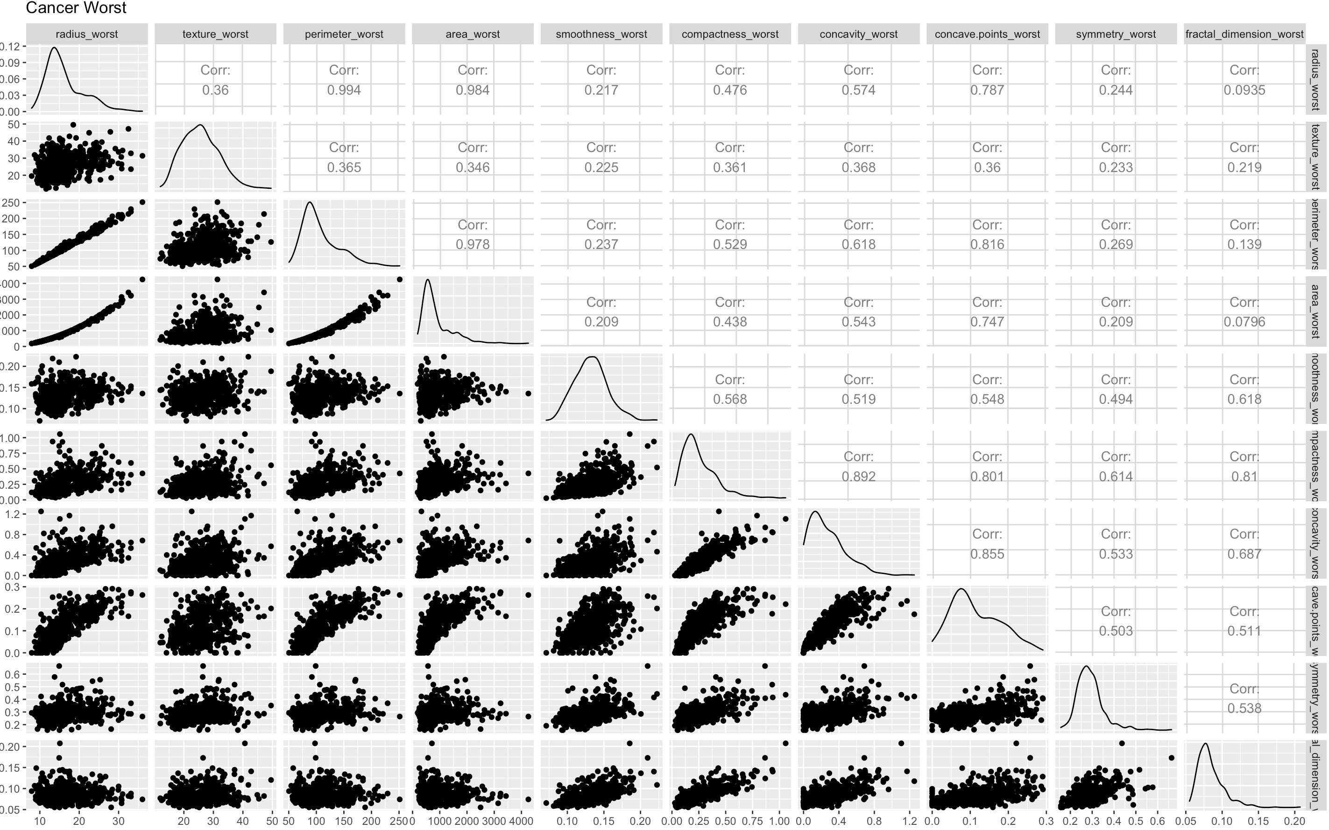
Correlation test
Highly correlation between some variables.

Slide 26
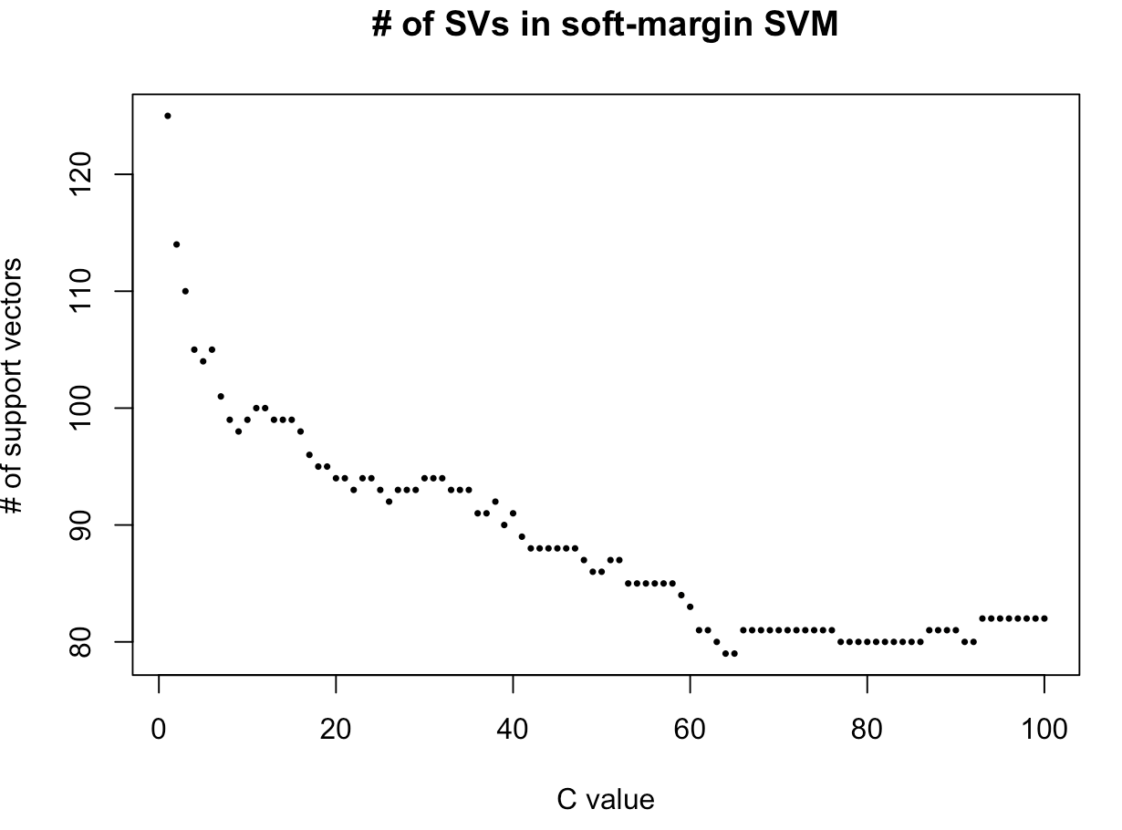
Data Processing
The number of support vectors goes done with the increasing of the cost value.

Slide 27
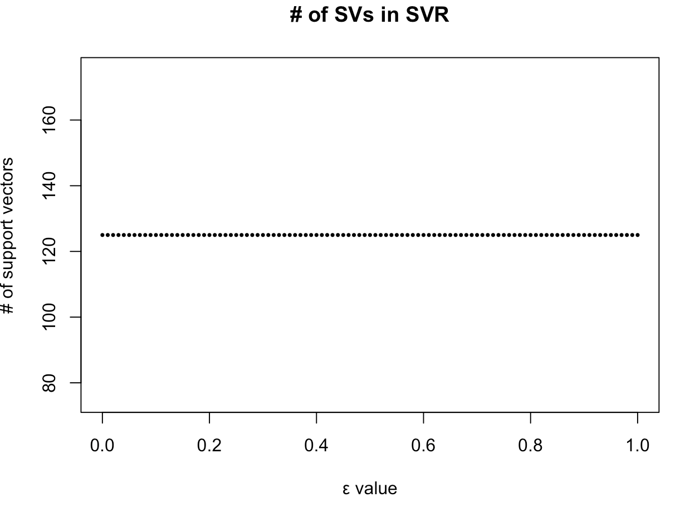
Data Processing
The number of support vectors will not change with the increasing of the epsilon value.

Slide 28
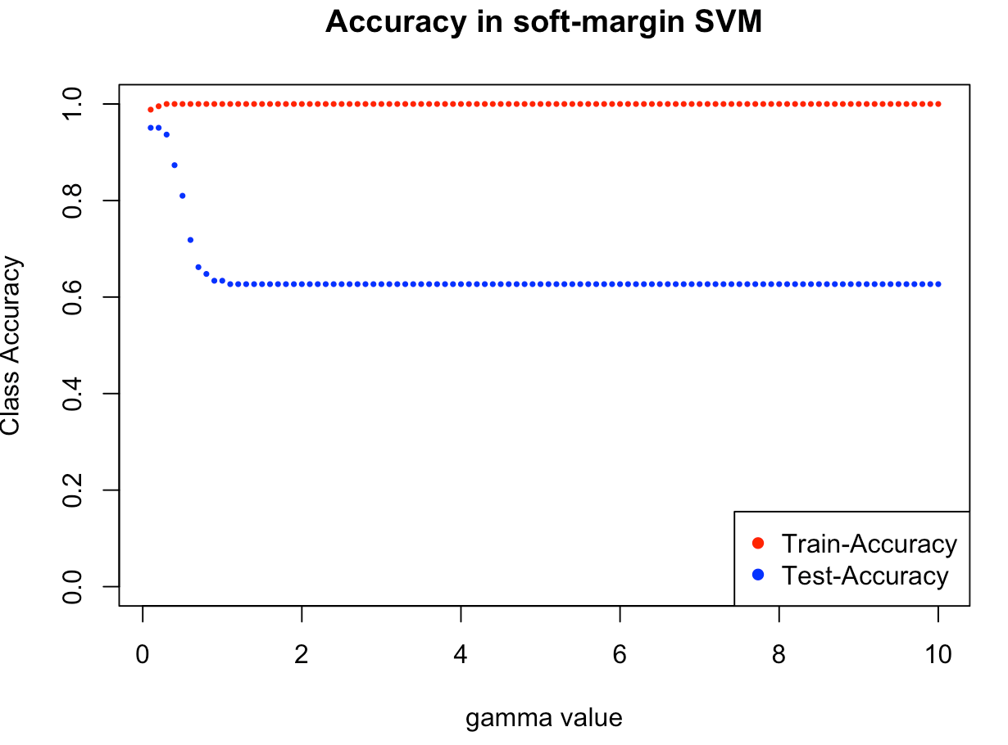
Data Processing
For RBF kernel fuction: Increasing the gamma value lead the overfitting

Slide 29
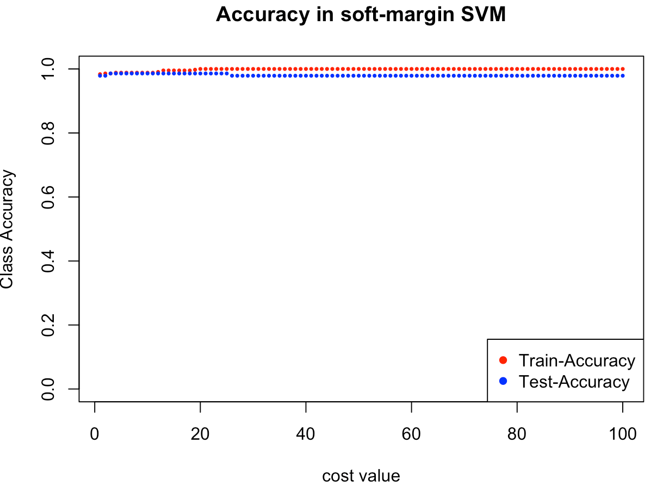
Data Processing
For RBF kernel fuction: Increasing the cost value lead the overfitting

Slide 30
k-Fold Cross-Validation
Cross-validation is a technique that is used for the assessment of how the results of statistical analysis generalize to an independent data set. Cross-validation is largely used in settings where the target is prediction and it is necessary to estimate the accuracy of the performance of a predictive model.
In the project, both SVM model and GLM model are use 10-Fold Cross-Validation

Slide 31
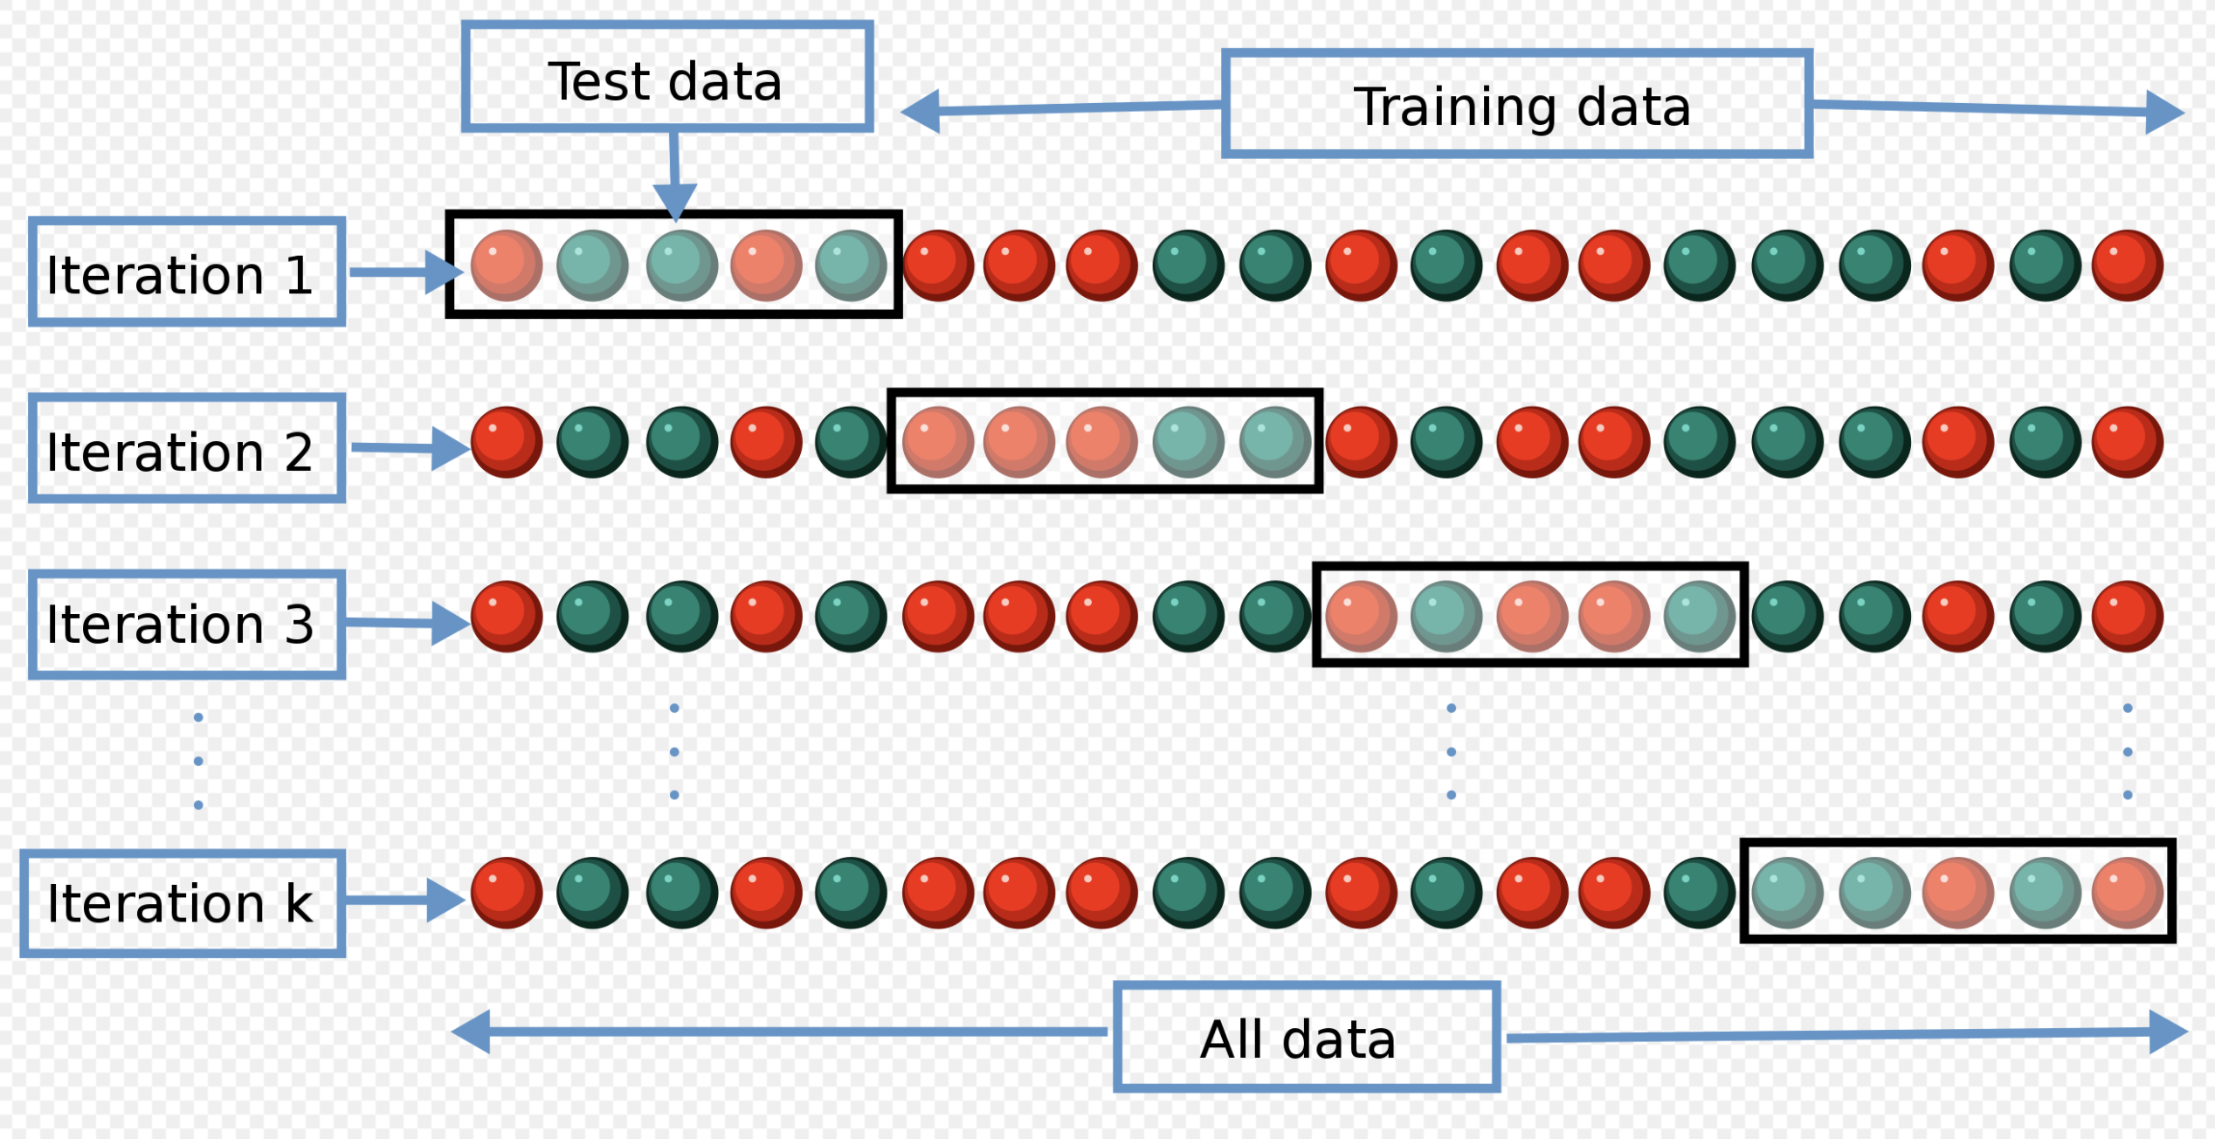
k-Fold Cross-Validation
Source: https://en.wikipedia.org/wiki/Cross-validation_(statistics)

Slide 32
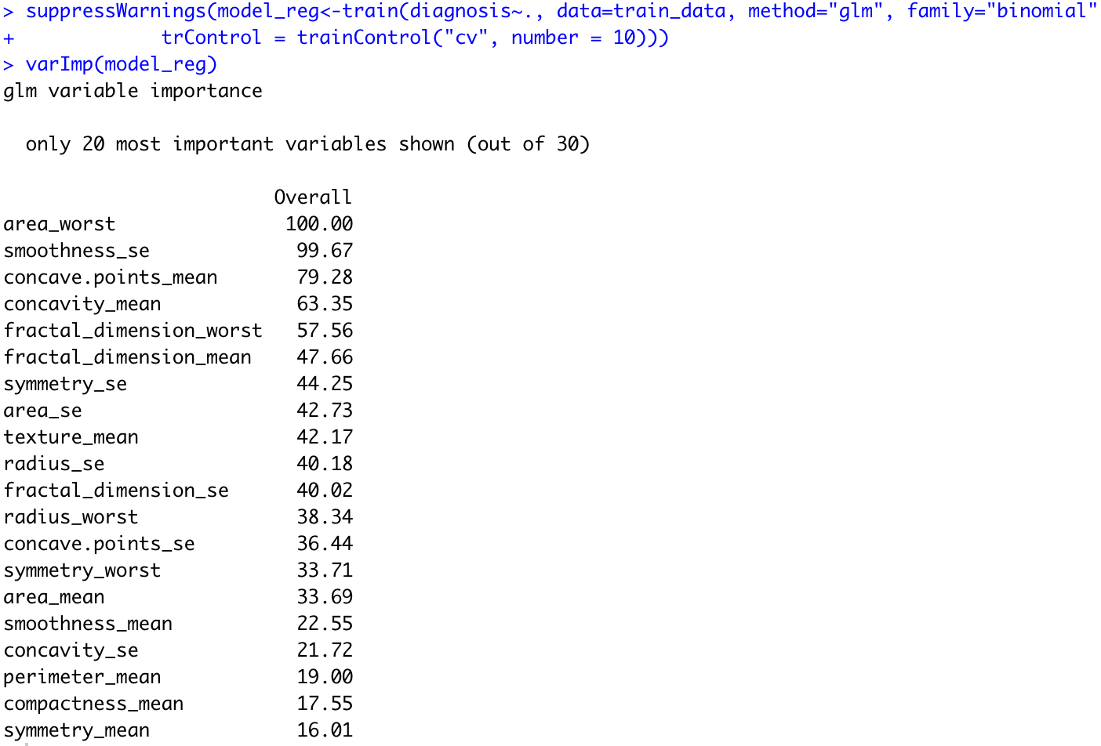
Generalized Linear Model
Get the GLM model using 10-Fold Cross Validation. We can see the most important variable is area_worst.

Slide 33
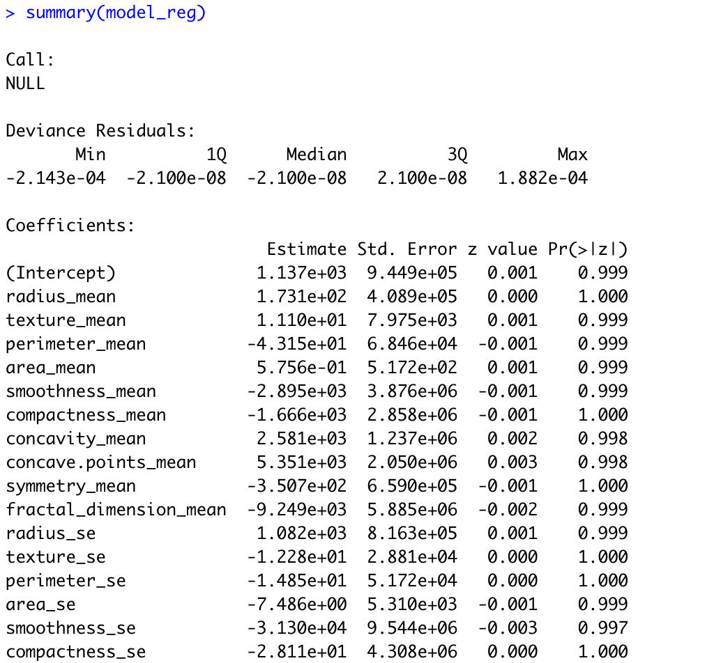
Generalized Linear Model
But all of the coefficients in the model are vary small

Slide 34
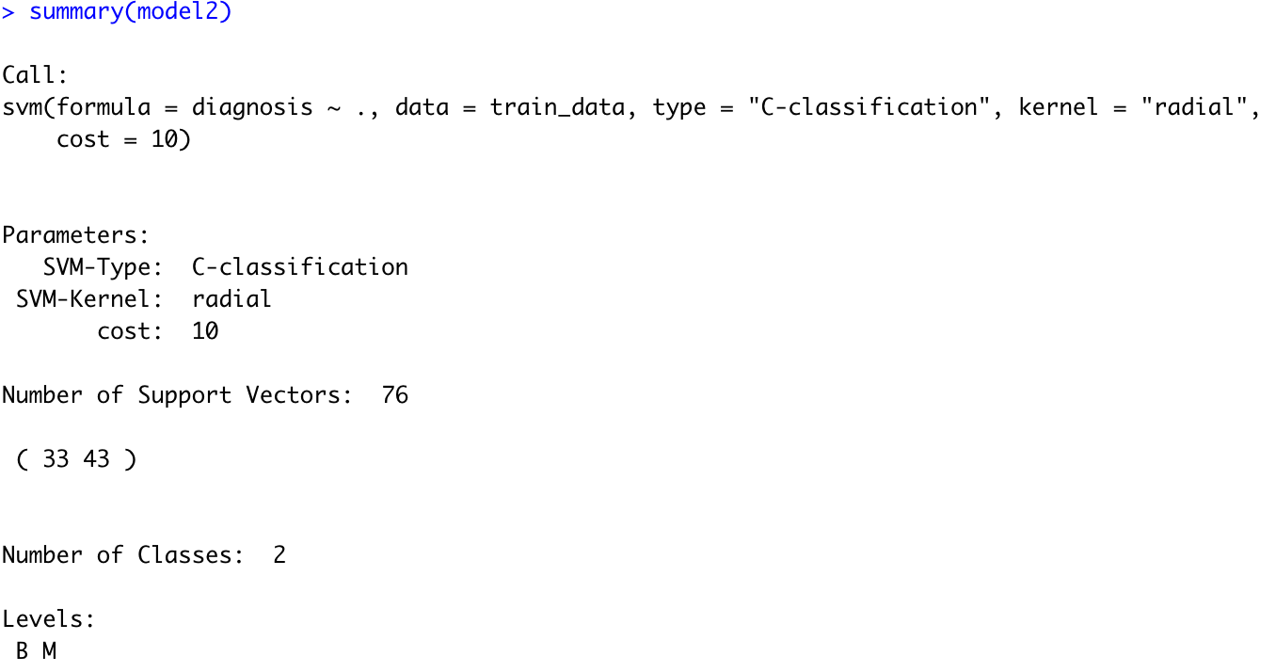
SVM output
Gamma default: 1/(data dimension)

Slide 35
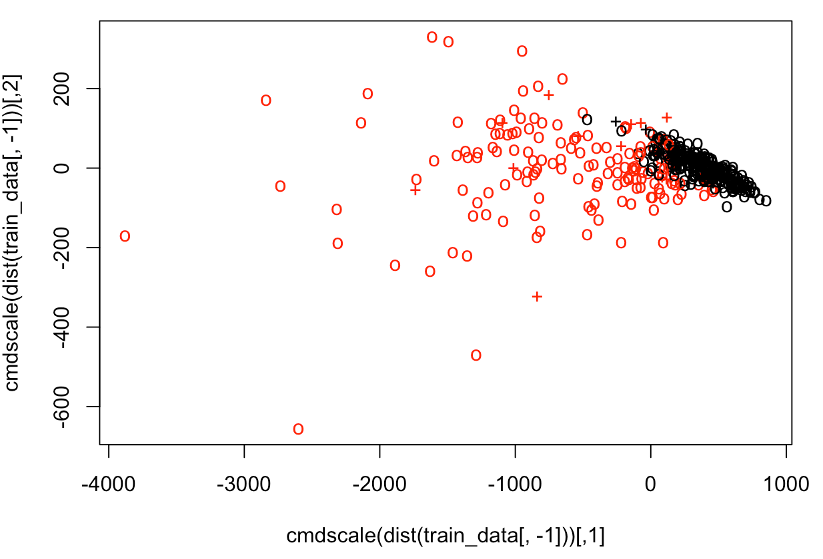
Data points
It’s hard to separate using linear function.

Slide 36
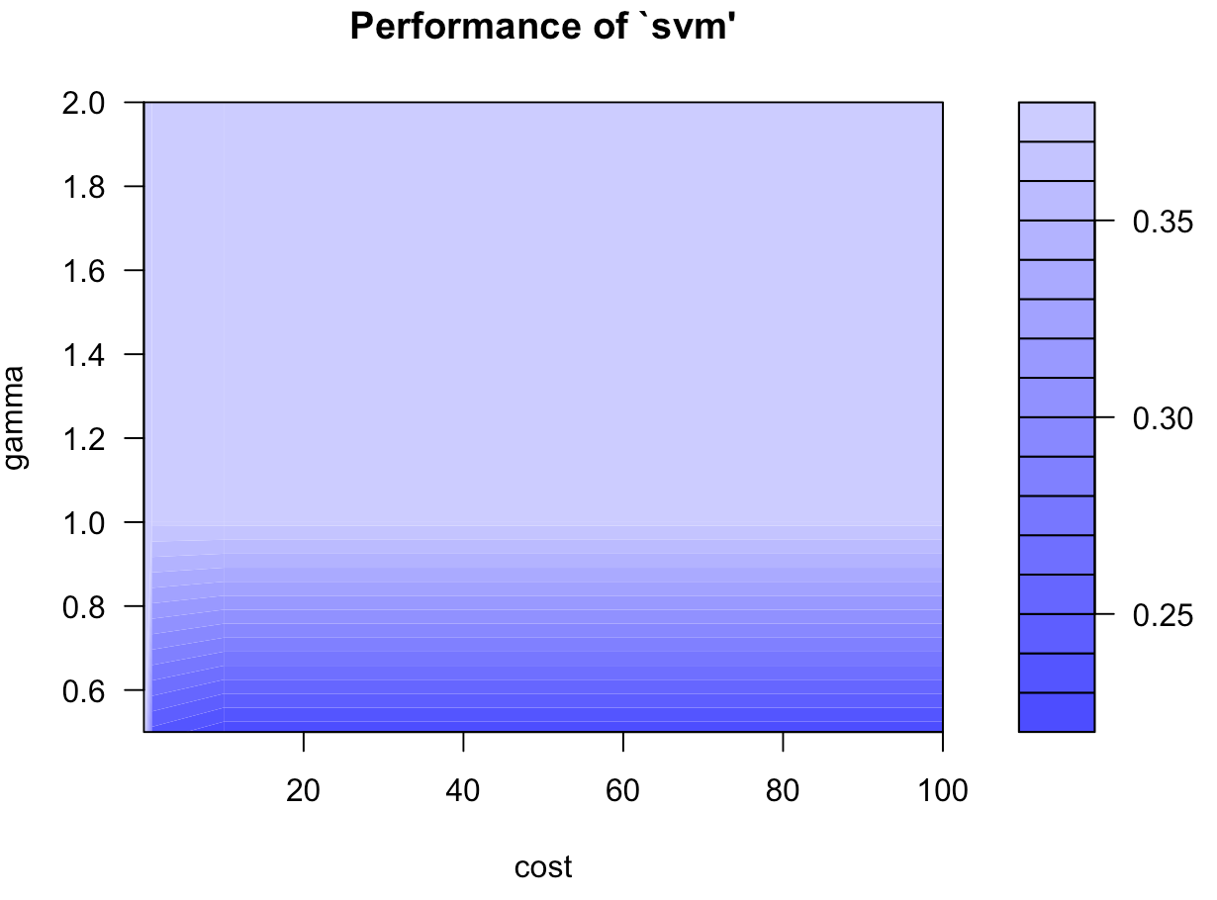
Best tune
The darker of the color mean lower classification error

Slide 37
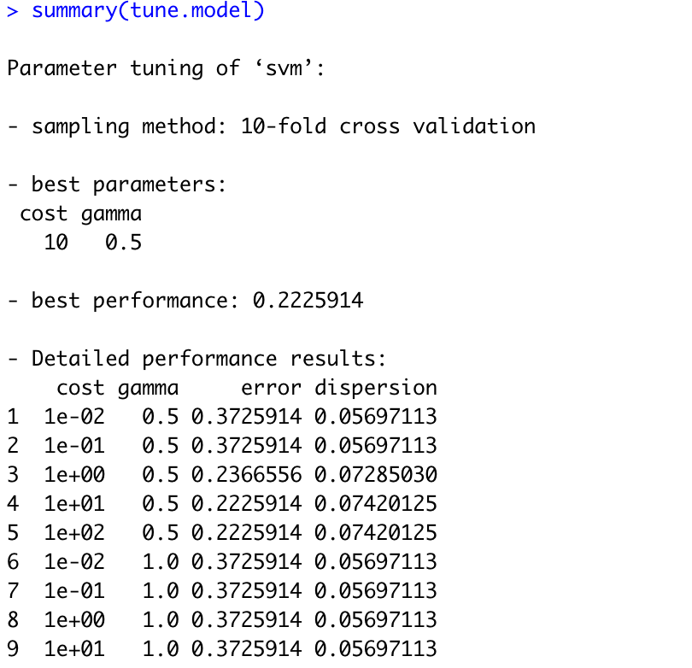
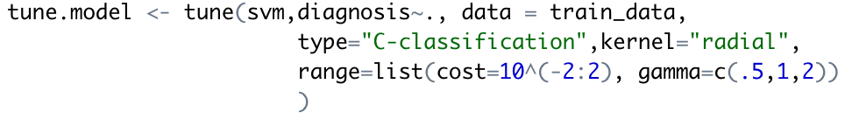
Best tune
From the R output, we can get the best Cost and gamma value is 10 and 0.5

Slide 38
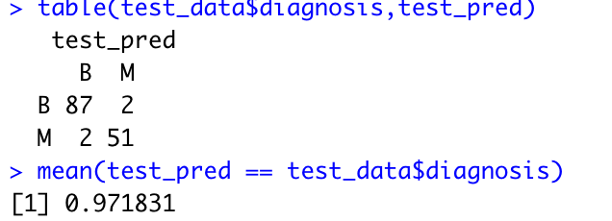
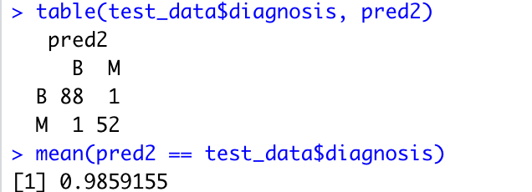
Model Comparison
Linear kernel VS Radial kernel

Slide 39
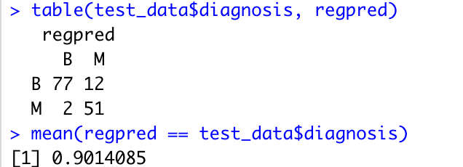
Model Comparison
GLM model VS SVM model with Radial kernel

Slide 40
Model Comparison
From two tables in last slides, It’s obvious that
Both two SMV models are much better than the generalized linear regression model.
The RBF kernel function is more appropriate for this dataset.

Slide 41
Summary

Slide 42
Pros and cons of SVM
Pros:
It is really effective in the higher dimension.
Effective when the number of features are more than training examples.
Best algorithm when classes are separable
The hyperplane is affected by only the support vectors thus outliers have less impact.
SVM is suited for extreme case binary classification.
Source: https://towardsdatascience.com/support-vector-machines-svm-c9ef22815589

Slide 43
Pros and cons of SVM
Cons:
For larger dataset, it requires a large amount of time to process.
Does not perform well in case of overlapped classes.
Selecting, appropriately hyperparameters of the SVM that will allow for sufficient generalization performance.
Selecting the appropriate kernel function can be tricky.
Source: https://towardsdatascience.com/support-vector-machines-svm-c9ef22815589

Slide 44
Why SVM is better for this data set
The dataset has many variable and SVM is good to handle a dataset with too many variable.
Many variables in the dataset have strong correlation, and linear regression model is not a good choice to deal with this kind of dataset.
It’s hard to separate the point just using linear function.

Slide 45
Reference
https://en.wikipedia.org/wiki/Support-vector_machine
https://towardsdatascience.com/support-vector-machines-svm-c9ef22815589
Huang, S., Cai, N., Pacheco, P.P., Narrandes, S., Wang, Y. and Xu, W., 2018. Applications of support vector machine (SVM) learning in cancer genomics. Cancer Genomics-Proteomics, 15(1), pp.41-51.
Crowley, J.L., 2012. Intelligent Systems: Reasoning and Recognition. Institut Polytechnique de Grenoble, Montbonnot, France. Lesson notes.
https://archive.ics.uci.edu/ml/datasets/Breast+Cancer+Wisconsin+%28Diagnostic%29
http://www.sthda.com/english/articles/36-classification-methods-essentials/144-svm-model-support-vector-machine-essentials/
https://rpubs.com/skydome20/R-Note14-SVM-SVR
https://towardsdatascience.com/breast-cancer-classification-using-support-vector-machine-svm-a510907d4878

Slide 46
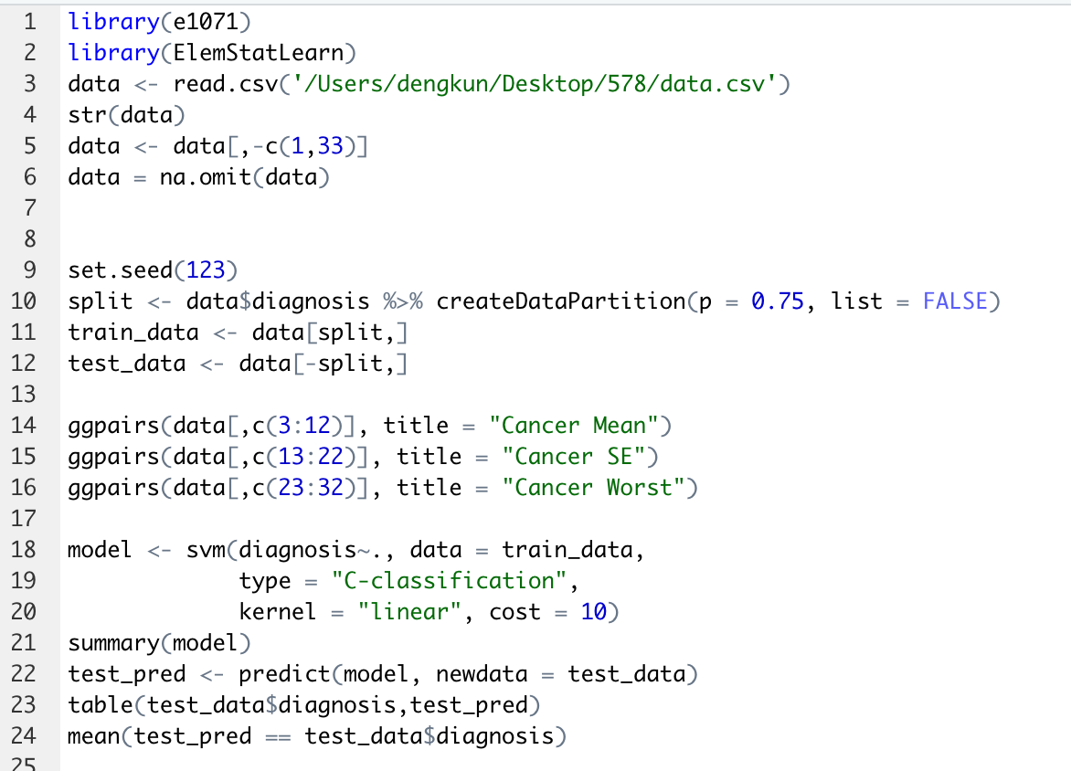
APPENDIX (code for breast cancerClassification in R)

Slide 47
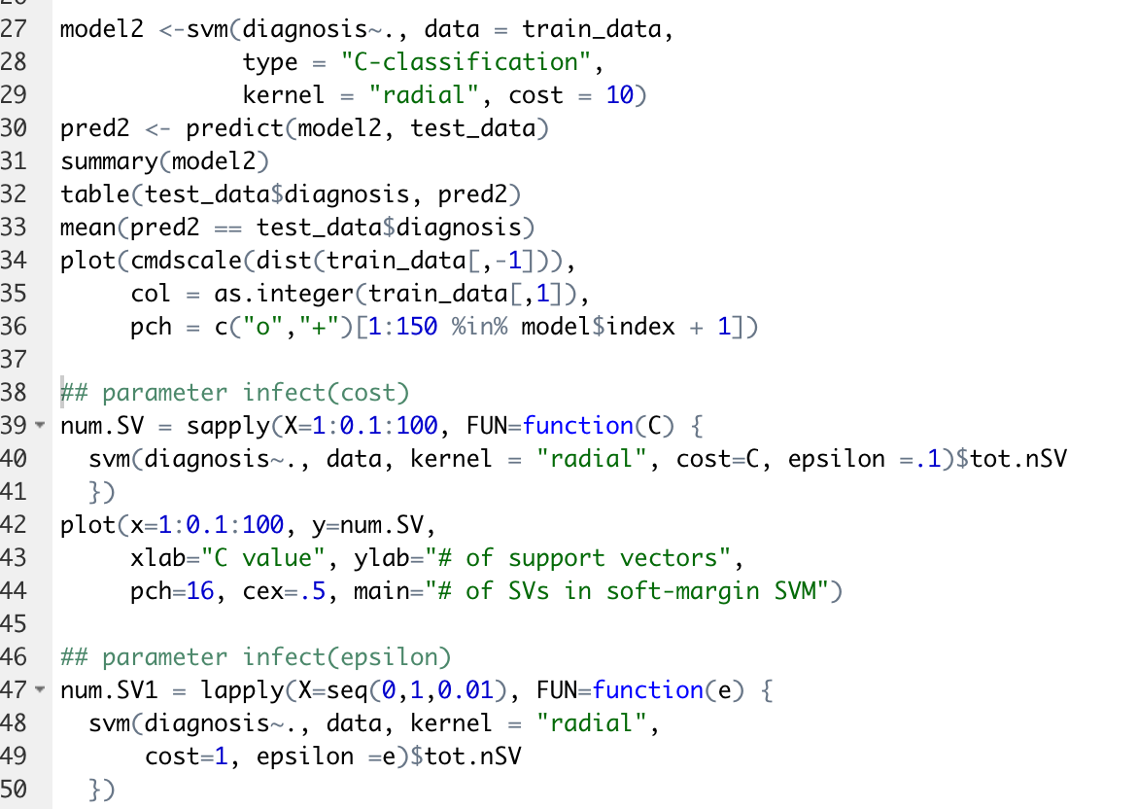
APPENDIX (code for breast cancerClassification in R)

Slide 48
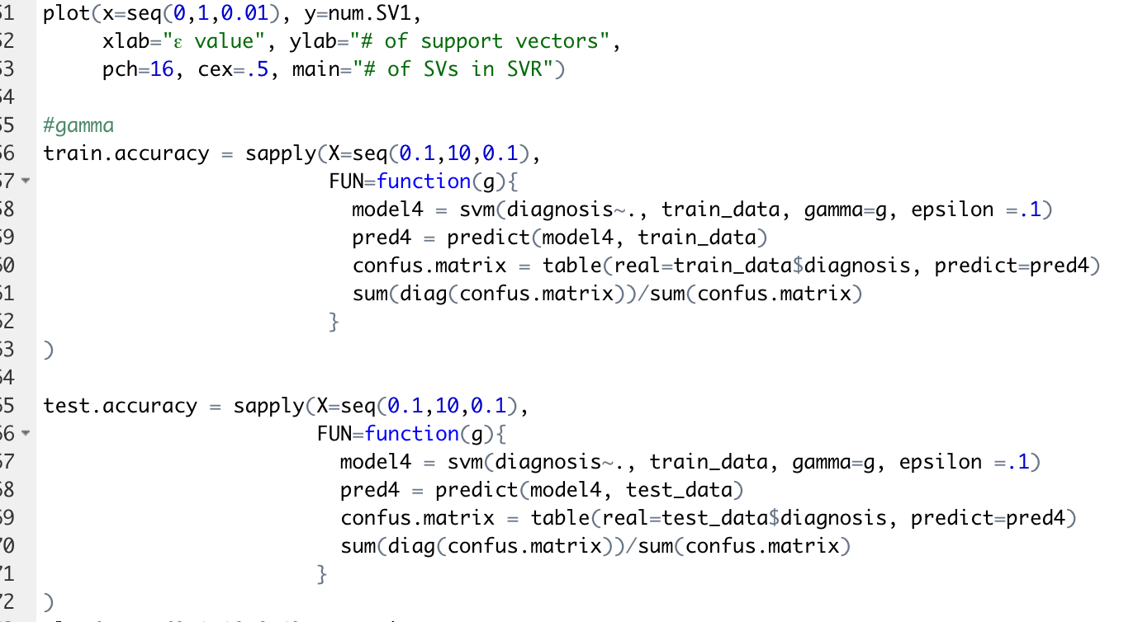
APPENDIX (code for breast cancerClassification in R)

Slide 49
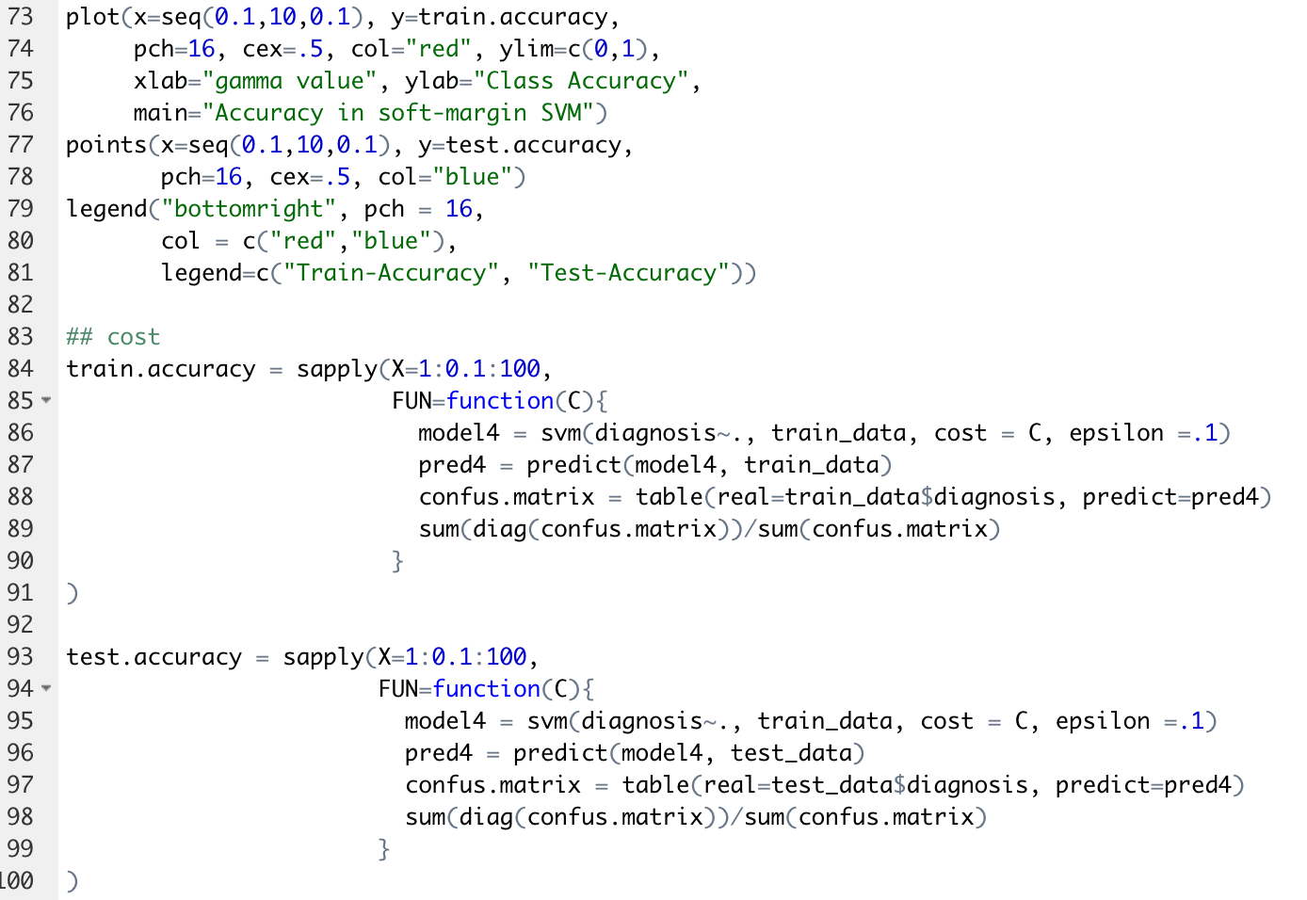
APPENDIX (code for breast cancerClassification in R)

Slide 50
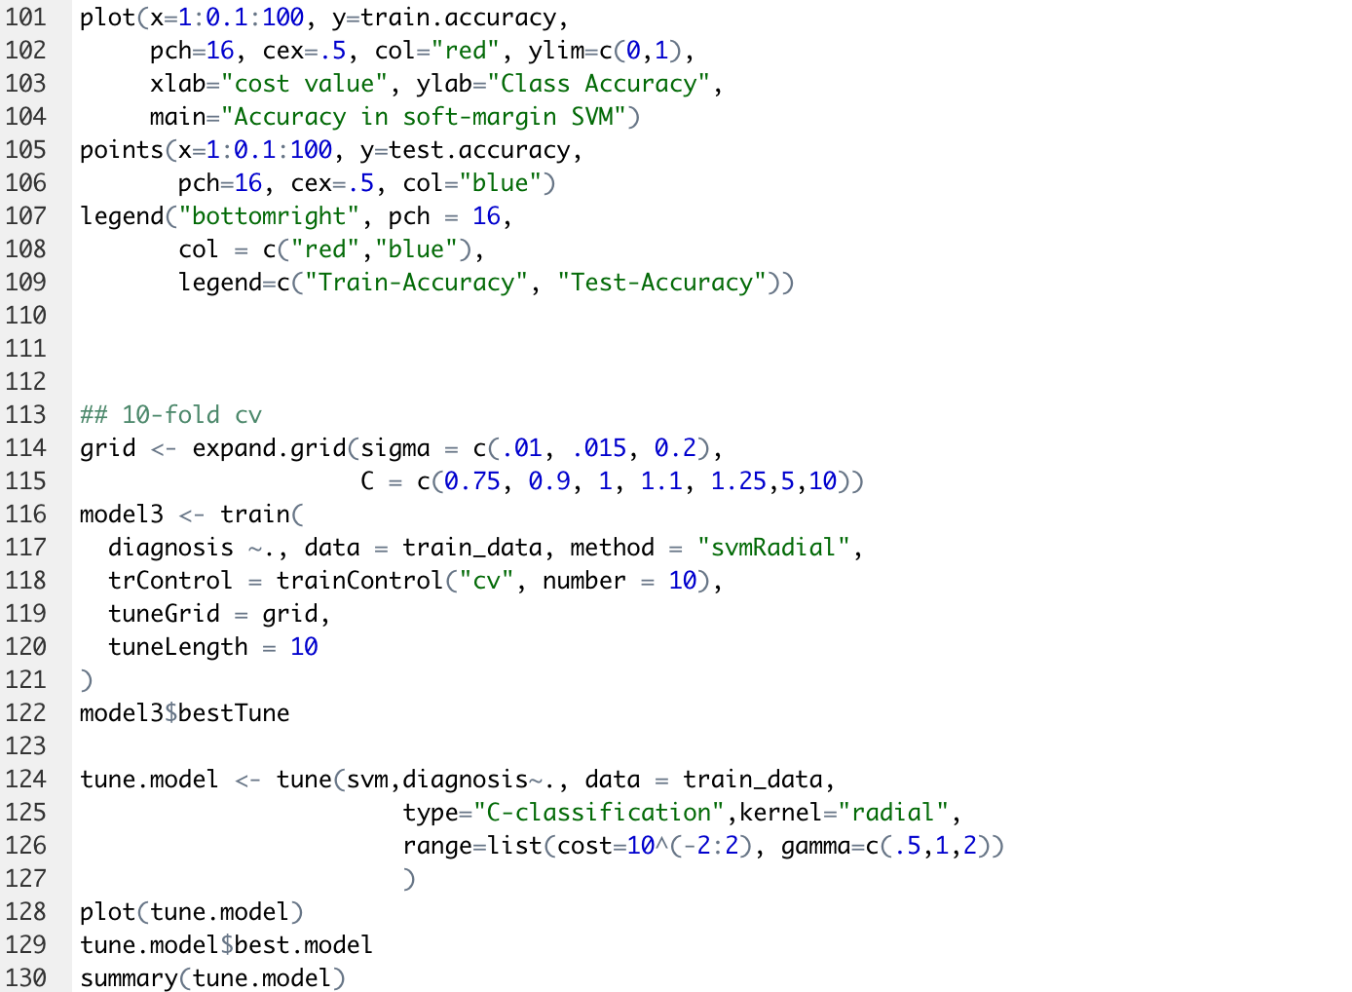
APPENDIX (code for breast cancerClassification in R)

Slide 51
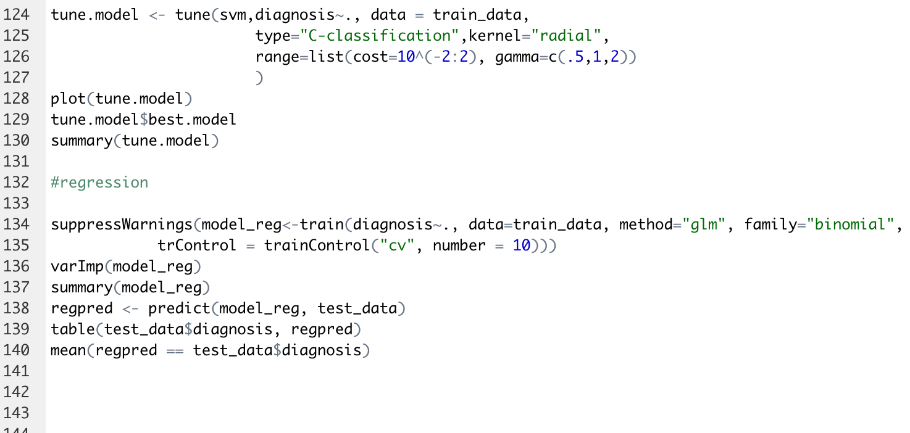
APPENDIX (code for breast cancerClassification in R)

